Slide 1

MGM Institute of Physiotherapy
Aurangabad
MAHATMA GANDHI MISSION
Didactic Lecture

Slide 2
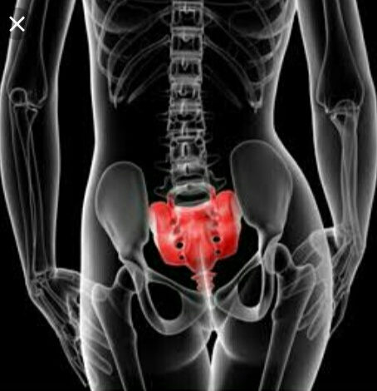
SI JOINT ASSESEMENT
Dr. surendra Wani
Dept. Of Musculoskeletal Physiotherapy
MGM Institute Of Physiotherapy
Chh. Sambhajinagar

Slide 3
Objectives
To understand and learn to assess the sacro illiac joint subjectively and objectively.

Slide 4
Contents-
.Introduction
.Subjective Assesement
.Objective Assesement
.Investigations
.Diagnosis

Slide 5
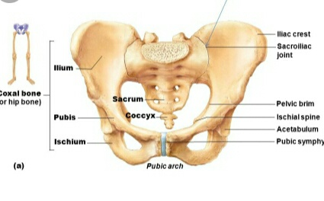
Introduction-

Slide 6
A)Subjective Assesement-
Demographic Data-
1.Age-What’s Patient’s Age
2.Occupation-Which Type Of Work Patient Perform

Slide 7
History Of Present Illness-
1.Was There Any Known Mechanism Of Injury
2.Has There been more than one episode
3.Does the patient have or feel any weakness in lower limbs
4.Has the patient had difficulty with micturation
5.Has there been a recent pregnancy

Slide 8
Pain Assesement-
1.When does the pain occur Does the pain keep the patient awake
2.Where is the pain ,does it radiate
3.Is there any particular position or activity that aggravate the condition

Slide 9
Special Questions-
Has the patient undergo x-ray examination or any other imaging

Slide 10
Past History-
1.Does the patient have past history of Rheumatoid Arthritis ,Reiter’s syndrome ,Ankylosing spondylitis
Drug History-
Personal History-
1.What’s patient’s usual technique activity or position that aggravates the condition

Slide 11
Occupational History-
1.Which type of patient’s work
Socieo-economic History
Environmental History

Slide 12
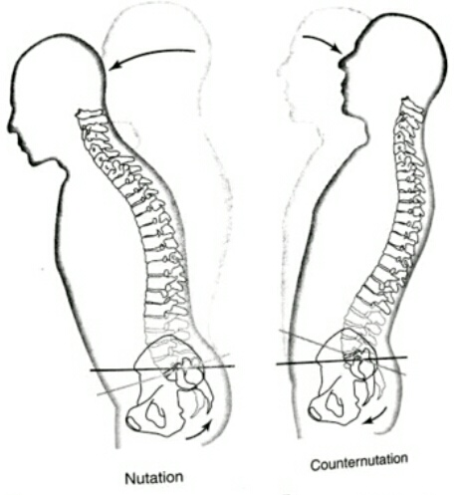
On Observation-
General Observation-

Slide 13
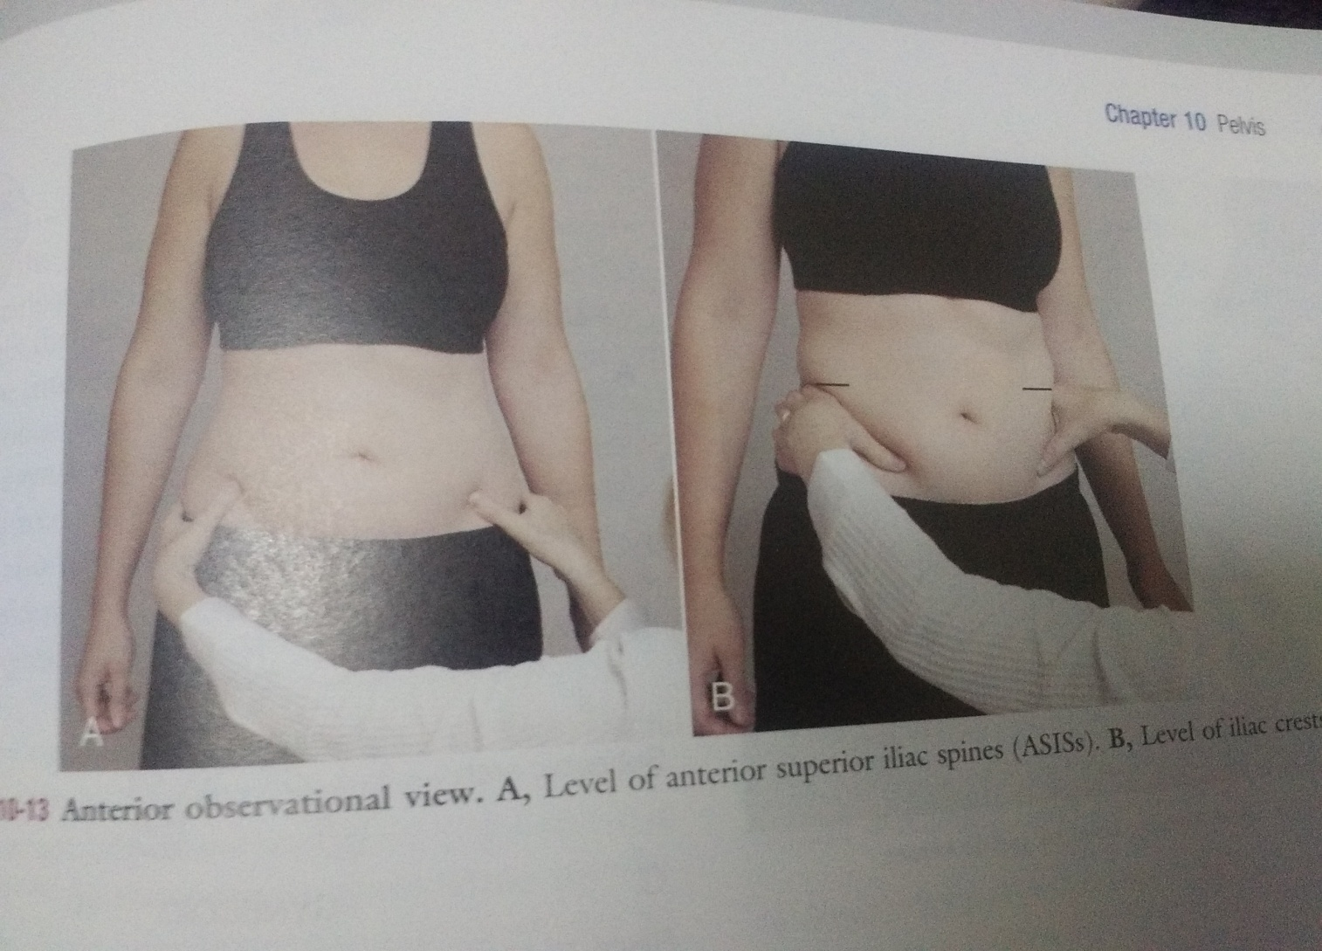

Slide 14
Local Physical Examination-
Tenderness
Sensory Examination
Joint Examination
Reflex
Limb Length
Gait analysis

Slide 15
INVESTIGATION:
DIAGNOSIS:

Slide 16
THANK YOU

